Slide 1
ETHICS LAWS for
LEGISLATORS
New Mexico Legislature | December 14, 2020
STATE ETHICS COMMISSION
Notes:
JDF

Slide 2
OUTLINE
The Two Most Important Ideas
Who We Are: Introduction to the State Ethics Commission
Public Trust Laws
Disclosure Laws
2 of 28
Notes:
JDF

Slide 3
TWO ORGANIZING IDEAS
1. Government belongs to the public
The property, powers, and prerogatives of government office belong to and are for the benefit of the public,
not the officials.
3 of 28
Notes:
JDF

Slide 4
TWO ORGANIZING IDEAS
2. Disclosure ensures representative government
Disclosure of who and what might influence an elected official allows constituents to check that the uses of government office are for the benefit of the public, and not the official.
4 of 28
Notes:
JDF

Slide 5
THESE TWO IDEAS ORGANIZE ALL THE ETHICS LAWS
Bribery and Solicitation Clause, N.M. Const., Art. IV, § 39
Interest in Contracts Clause, N.M. Const., Art. IV, § 28
GOVERNMENT BELONGS TO THE PUBLIC
Emoluments Clauses, N.M. Const., Art. IV, § 28, Art. X, § 1
Anti-Donation Clause, N.M. Const., Art. IX, § 14
Governmental Conduct Act
Lobbyist Regulation Act
Procurement Code
Gift Act
Campaign Reporting Act
Financial Disclosure Act
DISCLOSURE ENSURES REPRESENTATIVE GOVERNMENT
Governmental Conduct Act, §§ 10-16-3(C) & 10-16-4.2
Procurement Code, § 13-1-191.1
5 of 28
Notes:
JDF

Slide 6
WHO WE ARE
COMMISSIONERS & STAFF
6 of 28
Notes:
JDF

Slide 7
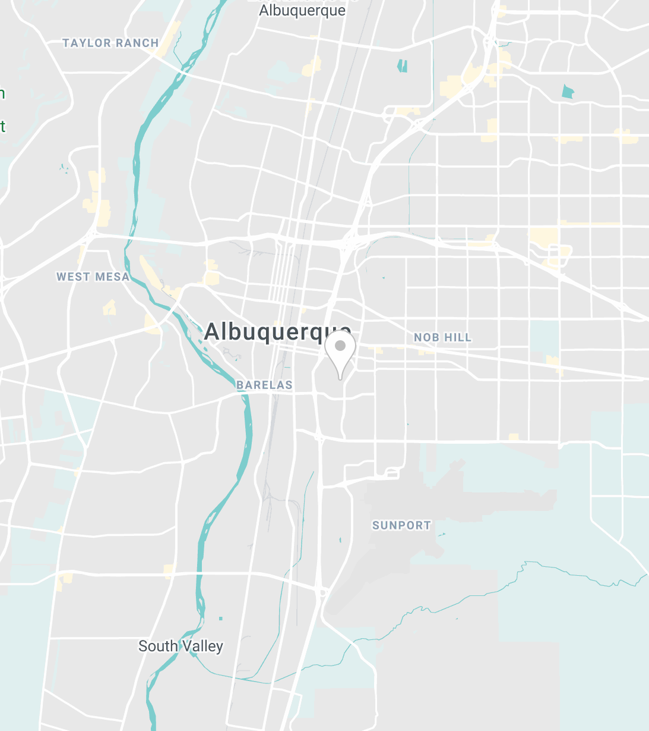
STATE ETHICS COMMISSION
7 COMMISSIONERS
5 STAFF MEMBERS
TYPE TEXT
800 Bradbury Drive SE, Suite 215 Albuquerque, NM
Nov. 6, 2018: Enacted in NM Constitution
July 1, 2019: First Commissioners Appointed
Jan. 1, 2020: Operations Began
7 of 28
Notes:
JDF

Slide 8
COMMISSIONERS & STAFF
Chair: Judge William F. Lang (ret.)​​​​ ​​
Appointing authority: Governor Michelle Lujan Grisham
Executive Director: Jeremy D. Farris​ ​​
Jeffrey L. Baker
Appointing authority: Legislatively Appointed Commissioners
Stuart M. Bluestone
General Counsel: Walker Boyd​ ​​
Appointing authority: Speaker of the House, Brian Egolf
Hon. Garrey Carruthers
Deputy General Counsel: Rebecca Branch​ ​​
Appointing authority: Minority Floor Leader of the Senate, Stuart Ingle
Ronald Solimon
Appointing authority: Legislatively Appointed Commissioners
Finance & Administration Director: Wendy George​ ​​
Dr. Judy Villanueva
Appointing authority: Minority Floor Leader of the House, James Townsend
Communications Director: Sonny C. Haquani​ ​​
Frances F. Williams
Appointing authority: President Pro Tempore of the Senate, Mary Kay Papen
8 of 28
Notes:
JDF

Slide 9
WHAT THE COMMISSION DOES
OPERATIONS AND PROCEDURES
9 of 28
Notes:
JDF

Slide 10
WHAT THE COMMISSION DOES
Adjudicates ethics complaints
Issues advisory opinions
Provides trainings and model code of ethics
Pursues civil enforcement
10 of 28
Notes:
JDF

Slide 11
ADJUDICATING ETHICS COMPLAINTS
Introduction to Complaint Process (1 of 2): Basic Procedure
Administrative cases in six steps:
Anyone with actual knowledge of a violation of the ethics laws may file an ethics complaint
Executive Director determines jurisdiction and routes initial motions
General Counsel investigates whether the allegations are supported by probable cause
Hearing officer holds public hearing and makes findings of fact and conclusions of law
Commission hears appeals from hearing officer decisions
A state district court may review a Commission’s final decision upon petition
Public disclosure rules
All documents in steps 1 through 3 are confidential and not subject to disclosure under IPRA.
The administrative case becomes public if and after the General Counsel determines probable cause and a hearing is set.
Citation: NMSA 1978, §§ 10-16G-10 to 10-16G-12; see also generally 1.8.3 NMAC.
11 of 28
Notes:
JDF

Slide 12
ADJUDICATING ETHICS COMPLAINTS
Introduction to Complaint Process (2 of 2): “Blackout Period”
If a person files an ethics complaint alleging violations of laws other than the Campaign Reporting Act or the Voter Action Act against a candidate less than 60 days before an election, the following rules apply:
The Commission cannot make that complaint public (but, as always, the complainant may release the complaint to the public)
The respondent may file an answer or a motion to dismiss (and, as always, the respondent may also release their response to the public)
Before the election, the Commission may dismiss the complaint for lack of jurisdiction or for not being support by probable cause
Before the election, the Commission cannot set a public hearing or hold a public hearing on the complaint
Purpose: The blackout period strikes a balance between (i) the public’s ability to allege ethics violations and (ii) the Commission’s responsibility to dismiss unfounded allegations and to shield candidates from a public hearing before the election
Citation: NMSA 1978, § 10-16G-15(B); 1.8.3.9(B) NMAC.
12 of 28
Notes:
JDF

Slide 13
INTRODUCTION TO ADVISORY OPINIONS
The Commission issues advisory opinions on the ethics laws
A request for an advisory opinion is confidential and not subject to IPRA
Requests must be in writing and set forth specific facts for the Commission to consider
Normally issued with 60-days upon request
Binding on the Commission in subsequent administrative complaint proceedings concerning a person who relied in good faith on the advisory opinion
To request and advisory opinion, email: ethics.commission@state.nm.us
​
Citation: NMSA 1978, § 10-16G-8; 1.8.1.9 NMAC.
13 of 28
Notes:
WB

Slide 14
TRAINING
“The state ethics commission shall advise and seek to educate all persons required to perform duties under the Governmental Conduct Act of those duties.”
“The commission may . . . offer annual ethics training to public officials, public employees, government contractors, lobbyists and other interested persons.”
Citation: NMSA 1978, §§ 10-16G-11(E), 10-16-13.1 & 10-16G-5(C)(5).
14 of 28
Notes:
JDF

Slide 15
ENFORCEMENT
The Commission may pursue civil enforcement of the statutes within its jurisdiction. For example, the following rules, inter alia, apply to the Commission’s civil enforcement of the Governmental Conduct Act.
“The state ethics commission shall seek first to ensure voluntary compliance with the provisions of the Governmental Conduct Act. A person who violates that act unintentionally or for good cause shall be given ten days' notice to correct the matter. Referrals for civil enforcement of that act shall be pursued only after efforts to secure voluntary compliance with that act have failed.”
“The state ethics commission may institute a civil action in district court if a violation has occurred or to prevent a violation of any provision of the Governmental action in district court or refer a matter to the attorney general or a district attorney to institute a civil Conduct Act. Relief may include a permanent or temporary injunction, a restraining order or any other appropriate order, including an order for a civil penalty of two hundred fifty dollars ($250) for each violation not to exceed five thousand dollars ($5,000).”
Citation: NMSA 1978, §§ 10-16-13.1(B) & 10-16-18(B) (GCA).
15 of 28
Notes:
JDF

Slide 16
ETHICS LAWS FOR LEGISLATORS
PUBLIC TRUST, GIFTS, & FINANCIAL DISCLOSURE
16 of 28
Notes:
JDF

Slide 17
PUBLIC TRUST RULES FOR LEGISLATORS
(1 of 5) The Main Rule
Members “shall use the power and resources of public office only to advance the public interest and not to obtain personal benefits or pursue private [including candidacy-related] interests.” § 10-16-3(A).
Other ethical laws are specific elaborations on this main rule. For example:
§§ 10-16-6 and 13-1-195 (each requiring that members not use confidential information acquired by virtue of their office for their private gain).
§ 10-16-4 (doesn’t apply to legislators) (prohibiting official acts for primary purpose of directly enhancing financial position, and requiring disqualification from acts directly affecting a financial interest proportionately greater than a benefit to the general public)
Citation: NMSA 1978, § 10-16-3(A).
17 of 28
Notes:
JDF

Slide 18
PUBLIC TRUST RULES FOR LEGISLATORS
(2 of 5) No Exchanging Official Acts for Things of Value
Members may not request or receive, and no person may offer a member, any money, thing of value or promise thereof that is conditioned upon or given in exchange for promised performance of an official act. § 10-16-3(D).
Members may not vote or use their influence for or against any matter pending in either house in exchange for money, thing of value, or promise thereof. N.M. Const., Art. IV, § 39.
Members may not solicit from any person or corporation any money, thing of value or personal advantage for the members’ vote or influence. N.M. Const., Art. IV, § 39.
Citation: N.M. Const., Art. IV, § 39; NMSA 1978, § 10-16-3(D).
18 of 28
Notes:
JDF

Slide 19
PUBLIC TRUST RULES FOR LEGISLATORS
(3 of 5) Doing Business with State or Local Government
Members may not “be interested directly or indirectly in any contract” that was authorized by a law enacted during your term and for one year after the term completes. N.M. Const., Art. IV, § 28.
Members, members’ families (spouse, parents, children and siblings), and businesses in which members have substantial interests may not contract with state agencies unless:
(1) the legislator has disclosed the interest in the business; and
(2) the contract is awarded in accordance with the provisions of the Procurement Code, and, for the purposes of this condition, the sole source and small purchase contract exceptions do not apply. § 10-16-9(A).
Citation: N.M. Const., Art. IV, § 28; NMSA 1978, § 10-16-9(A).
19 of 28
Notes:
JDF

Slide 20
PUBLIC TRUST RULES FOR LEGISLATORS
(4 of 5) Representing Clients Before State Agencies
Members may not represent or assist another person in a matter before a state agency, unless:
(1) the representation or assistance is pro bono;
(2) the representation or assistance is for the benefit of a constituent; or
(3) you are an attorney or professional engaged in the conduct of your profession.
If a member represents someone before a state agency, that member may not:
(1) reference his or her legislative office except as to matters of scheduling;
(2) use legislative stationary; or
(3) make threats or implications related to legislative action.
Citation: NMSA 1978, § 10-16-9(B).
20 of 28
Notes:
JDF

Slide 21
PUBLIC TRUST RULES FOR LEGISLATORS
(5 of 5) On Revolving Doors
No member shall be appointed to any civil office created, or the emoluments of which were increased, during their term or for one year thereafter. N.M. Const., Art. IV, § 28.
No member shall accept employment as a lobbyist for compensation contingent in whole or in part upon the outcome of lobbying activities before the legislative branch of state government or the approval or veto of any legislation by the governor. § 2-11-8.
Citation: N.M. Const., Art. IV, § 28; NMSA 1978, § 2-11-8.
21 of 28
Notes:
JDF

Slide 22
GIFT RULES FOR LEGISLATORS
(1 of 3): Limitations on Gifts
$250 From Restricted Donors
Members, members’ spouses, and members’ dependent children may not accept a gift valued at more than $250 from any “restricted donor”—including lobbyists, lobbyists’ clients, persons doing business or seeking to do business with the legislature, or a person who will be disproportionately affected by a member’s official duties. See NMSA 1978, § 10-16B-3(A).
$1000 Aggregate Limit for Lobbyists
Lobbyists, lobbyists’ clients, and government contractors shall not give gifts of an aggregate value of greater than $1000 in a calendar year to any member or candidate. § 10-16B-3(B).
Solicitations to Charities
Members may not solicit donations for a charity where it appears that the purpose of the donor in making the gift is to influence the member in the performance of an official duty. § 10-16B-3(C).
Citation: NMSA 1978, § 10-16B-3.
22 of 28
Notes:
WB

Slide 23
GIFT RULES FOR LEGISLATORS
(2 of 3): Exceptions to the Limitations on Gifts
Transfers
The Gift Act excludes many kinds of transfers from the limitations on gifts. See § 10-16B-2(B).
Technical Exclusions
Check with the Legislative Counsel Service or the State Ethics Commission. E.g., State Ethics Commission Advisory Opinion 2020-03 (concluding that Holtec’s provisions of flights and lodging to legislators visiting a Missouri nuclear plant is not a “gift” subject to the Gift Act’s limitations because it had an educational purpose).
Citation: NMSA 1978, § 10-16B-2(B).
23 of 28
Notes:
WB

Slide 24
GIFT RULES FOR LEGISLATORS
(3 of 3): Honoraria
Accepting or Requesting
No legislator, public officer or employee may request or receive an honorarium for a speech or service rendered that relates to the performance of public duties.
Definition
“Honorarium” means payment of money, or any other thing of value in excess of one hundred dollars ($100), but does not include reasonable reimbursement for meals, lodging or actual travel expenses incurred in making the speech or rendering the service, or payment or compensation for services rendered in the normal course of a private business pursuit.
Citation: NMSA 1978, § 10-16-4.1.
24 of 28
Notes:
WB

Slide 25
FINANCIAL DISCLOSURE RULES FOR LEGISLATORS​
(1 of 2): The Financial Disclosure
Must be filed with the Secretary of State every January
Updated financial disclosure due every January during your term of service
You must provide information about yourself and your spouse.
Citation: NMSA 1978, § 10-16A-3.
25 of 28
Notes:
WB
Note that beginning in 2021, financial disclosures need to be filed electronically on the Secretary of State’s new CFIS system.

Slide 26
FINANCIAL DISCLOSURE RULES FOR LEGISLATORS​
(2 of 2): Content of Financial Disclosure
Name, mailing address, residence address of the filer
Employer and position held
Sources of gross income above $5,000
Need only disclose category of source ( “oil and gas” is enough; “Marathon Petroleum” allowed but not required)
Area of specialization must be disclosed if source of income is a law practice or consulting firm.
Real estate holdings
Type: e.g., “ranch” or “rental house”
County where the property is located
New Mexico business interests above $10,000 not otherwise listed
Memberships on boards of for-profit businesses
New Mexico professional licenses held
Each state agency to which you sold goods or services in excess of $5,000
Each state agency, other than a court, before which you represented or assisted a client in the course of employment
Citation: NMSA 1978, § 10-16A-3.
26 of 28
Notes:
WB

Slide 27
Resources on the Ethics Laws​
New Mexico Legislative Ethics Guide (Legis. Council Serv., Dec. 2020)
Governmental Conduct Act Compliance Guide (N.M. Att’y Gen., 2015).​​
State Ethics Commission’s Model Code of Ethics: 1.8.4 NMAC (forthcoming Dec. 24, 2020).
27 of 28
Notes:
WB

Slide 28
QUESTIONS AND COMMENTS
www.sec.state.nm.us
CONNECT WITH THE SEC
ethics.commission@state.nm.us
@NMETHICS
28 of 28
Notes:
WB

